Slide 1

JavaScript, Sixth Edition
Chapter 10
Programming for Touchscreens and Mobile Devices

Slide 2
Objectives
When you complete this chapter, you will be able to:
Integrate mouse, touch, and pointer events into a web app
Obtain and work with a user's geolocation information
Optimize a mobile web app to accommodate the common constraints experienced by mobile users
JavaScript, Sixth Edition

Slide 3
Using Touch Events and Pointer Events
On touchscreen device without a moust
  browsers fire click event when user touches screen
Other events don't translate neatly for touchscreens
JavaScript, Sixth Edition

Slide 4
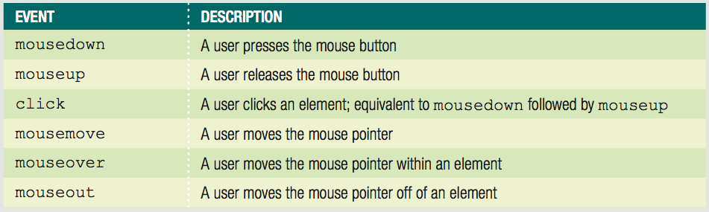
Creating a Drag-and Drop Application with Mouse Events
Mouse events
  events based on actions of mouse or touchpad
Table 10-1 Mouse events
JavaScript, Sixth Edition

Slide 5
Understanding Mouse Events on a Touchscreen Device
On a touchscreen device
  Some web page elements respond to mouse events
  div element not considered clickable
    doesn't fire mouse events on touchscreen
  links and form elements are clickable
    browsers respond to touch
Touch cascade
  Browser checks a touched element for an event handler for multiple events
    Including some mouse events
JavaScript, Sixth Edition

Slide 6
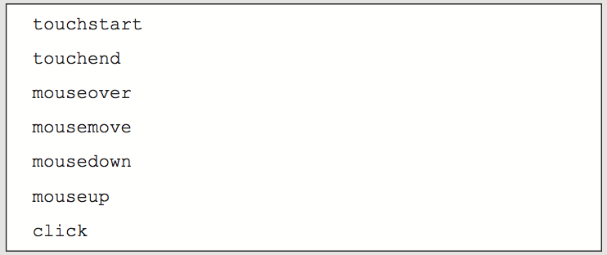
Understanding Mouse Events on a Touchscreen Device (cont'd.)
Figure 10-5 Touch cascade order
JavaScript, Sixth Edition

Slide 7
Understanding Mouse Events on a Touchscreen Device (cont'd.)
Touchscreen devices fire touchscreen-specific events for some elements
  Touch events created by Apple
    Used on Apple iOS and Google Android
  Pointer events created by Microsoft
    Used on Windows Phone and Windows 8 and higher
JavaScript, Sixth Edition

Slide 8
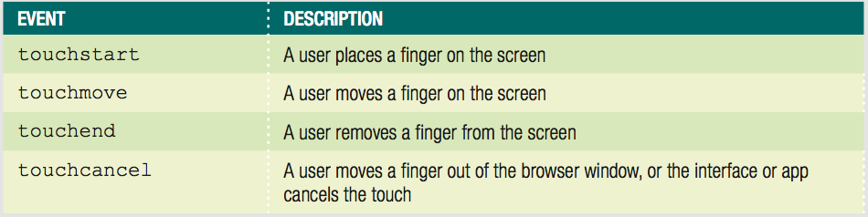
Implementing Touch Events
Respond to user's finger touches on a touchscreen
Table 10-2 Touch events
JavaScript, Sixth Edition

Slide 9
Implementing Touch Events (cont'd.)
touchstart event
  analogous to mousedown mouse event
touchmove event
  corresponds to mousemove
touchend event
  similar to mouseup
touchcancel event
  unique to touchscreen
JavaScript, Sixth Edition

Slide 10
Implementing Touch Events (cont'd.)
Working with Touch Coordinates
  Mouse events can work with event properties
    clientX property = x coordinate of event
    clientY property = y coordinate of event
  Touch events support multitouch devices
    Allow for multiple touches on screen at once
    Don't support clientX or clientY properties as direct children
    Each touch event has array properties
JavaScript, Sixth Edition

Slide 11
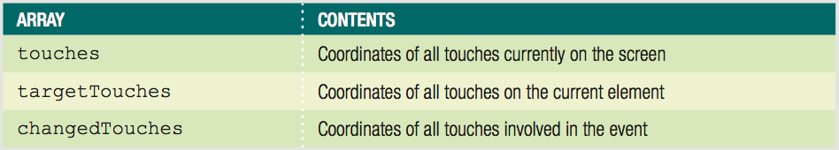
Implementing Touch Events (cont'd.)
Table 10-3 Array properties of touch events
JavaScript, Sixth Edition

Slide 12
Implementing Touch Events (cont'd.)
Distinguishing Between App and Device Interaction
  Touchscreen devices use touch events for more than one purpose
    Can interact via touch with an app
    Use touch to perform gestures
      Browser and device interactions like scrolling
  Use preventDefault() method
    Ensures that OS interface doesn't respond to events when users interact with your app
JavaScript, Sixth Edition

Slide 13
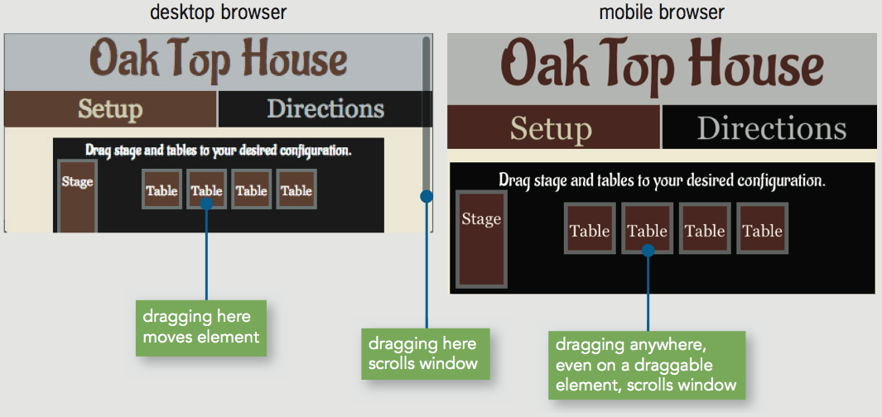
Implementing Touch Events (cont'd.)
Figure 10-7 Multiple uses of a single touch event
JavaScript, Sixth Edition

Slide 14
Implementing Pointer Events
Touchscreens on new types of devices
  Tablets
  Notebook computers
Makes coding for touch and mouse events more complicated
  Some devices support stylus input
  Some devices have trackpads
JavaScript, Sixth Edition

Slide 15
Implementing Pointer Events (cont'd.)
Microsoft pointer events
  Aim to handle input from mouse, finger, or stylus with each event
  Incorporate other event properties
    Pressure on screen
    Angle of stylus
Only IE Mobile and IE 10 and later support pointer events
Some versions of IE do not recognize touch events
  Use mouse+touch+pointer for max. compatibility
JavaScript, Sixth Edition

Slide 16
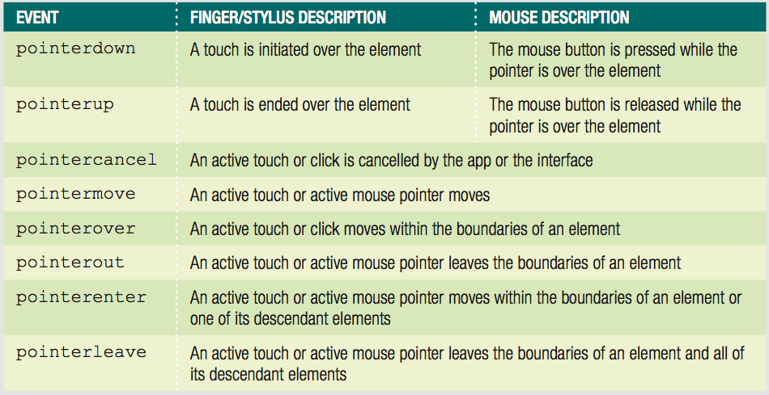
Implementing Pointer Events (cont'd.)
Table 10-4 Pointer events
JavaScript, Sixth Edition

Slide 17
Implementing Pointer Events (cont'd.)
Identifying pointer screen coordinates
  clientX and clientY properties like mouse events
Stopping OS gestures
  Requires setting msTouchAction CSS property
    Set value to none
JavaScript, Sixth Edition

Slide 18
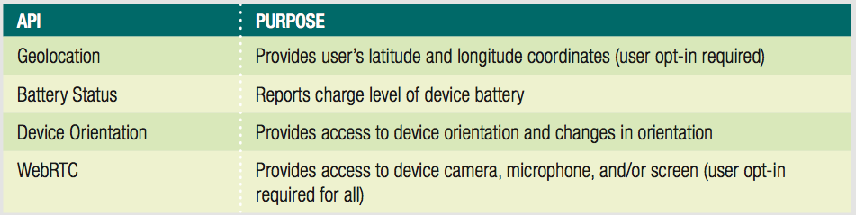
Using Programming Interfaces for Mobile Devices
APIs available to access information provided by mobile device hardware
Table 10-5 Selected hardware APIs for mobile devices
JavaScript, Sixth Edition

Slide 19
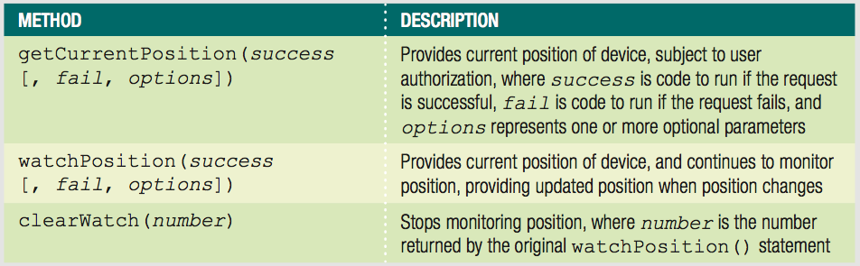
Using the Geolocation API
Provides access to user's latitude & longitude
Accessed using geolocation property of Navigator object
Table 10-5 Selected hardware APIs for mobile devices
JavaScript, Sixth Edition

Slide 20
Using the Geolocation API (cont'd.)
Callbacks
  Arguments that contain/reference executable code
getCurrentPosition() method
  Request user's position a single time
JavaScript, Sixth Edition

Slide 21
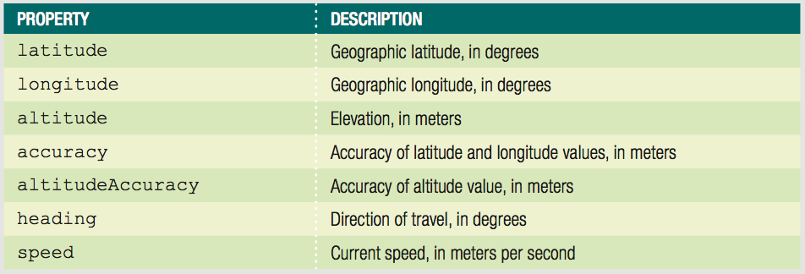
Using the Geolocation API (cont'd.)
Table 10-7 Properties passed on a successful geolocation request
JavaScript, Sixth Edition

Slide 22
Using the Geolocation API (cont'd.)
Basic example:
  navigator.geolocation.getCurrentPosition(showLocation);
  function showLocation(position) {
  console.log("Longitude: " + position.coords.longitude);
  console.log("Latitude: " + position.coords.latitude);
  }
JavaScript, Sixth Edition

Slide 23
Using the Geolocation API (cont'd.)
Enhanced example
  Handle failed request, set 10-second timeout:
  navigator.geolocation.getCurrentPosition(showLocation, fail,↵
  ^{{timeout: 10000});}
  function showLocation(position) {
  console.log("Longitude: " + position.coords.longitude);
  console.log("Latitude: " + position.coords.latitude);
  }
  ^{function fail() {}
  var content = document.getElementById("mainParagraph");
  content.innerHTML = "<p>Geolocation information not↵
  available or not authorized.</p>";
  }
JavaScript, Sixth Edition

Slide 24
Using the Geolocation API (cont'd.)
Need to fail gracefully in older browsers
  ^{if (navigator.geolocation {}
  navigator.geolocation.getCurrentPosition(createDirections,↵
  ^{fail, {timeout: 10000});}
  ^{} else {}
  ^{fail();}
  }
JavaScript, Sixth Edition

Slide 25
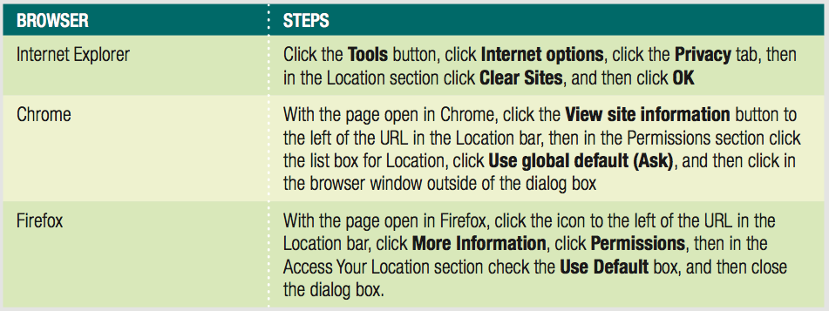
Using the Geolocation API (cont'd.)
Need to clear geolocation history for testing
Table 10-9 Steps to clear saved geolocation history
JavaScript, Sixth Edition

Slide 26
Using the Geolocation API (cont'd.)
Sometimes users don't notice or ignore geolocation request
  Request neither fails or succeeds
  Any dependent code not executed
JavaScript, Sixth Edition

Slide 27
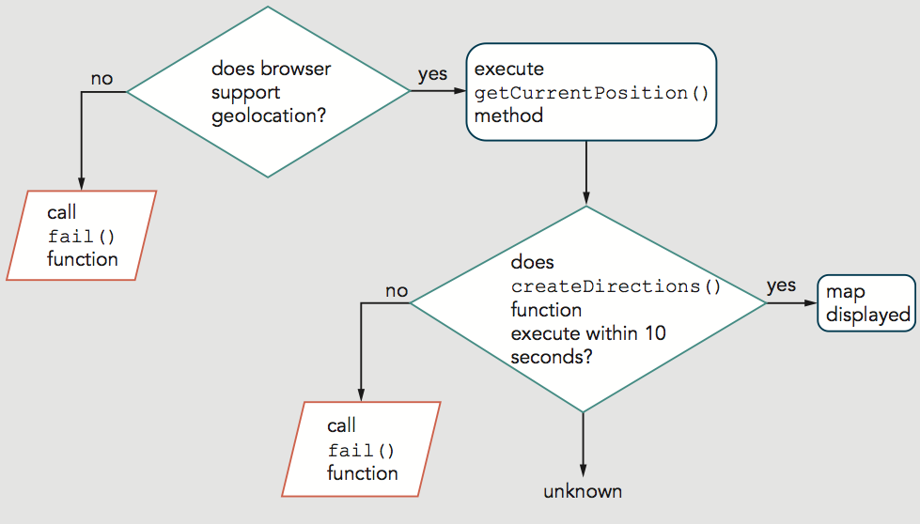
Using the Geolocation API (cont'd.)
Figure 10-10 Flowchart illustrating flow of current geolocation code
JavaScript, Sixth Edition

Slide 28
Using the Geolocation API (cont'd.)
Can handle lack of yes/no response from user
  setTimeout() method
  Start countdown before request
    If timeout expires, stop waiting and trigger failure code
    If user responds, cancel timeout
JavaScript, Sixth Edition

Slide 29
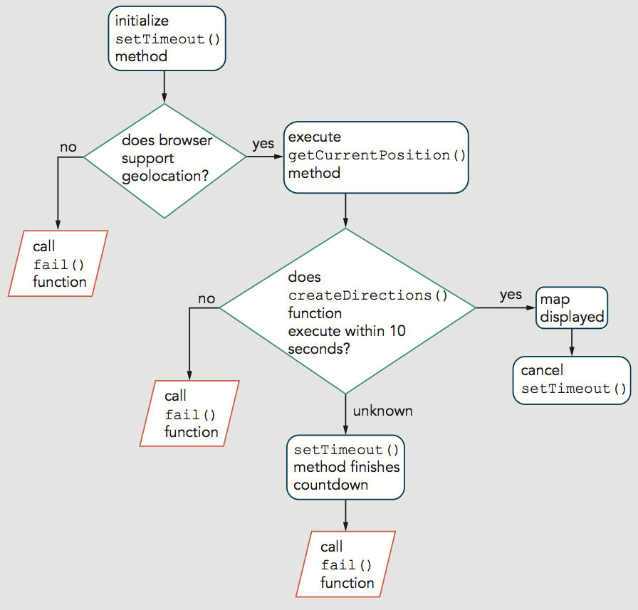
Using the Geolocation API (cont'd.)
Figure 10-11 Flowchart illustrating geolocation code that incorporates setTimeout()
JavaScript, Sixth Edition

Slide 30
Using the Geolocation API (cont'd.)
Code complete to acquire geolocation information
  Then you can integrate with databases
Using the Google Maps API
  Can display a map centered on user's location
  Can show route/directions between two locations
  Includes 2 constructors
    Map() creates a map object
    var name = new google.maps.Map(element, options);
    LatLng() creates an object containing coordinates
    center: new google.maps.LatLng(latitude, longitude)
JavaScript, Sixth Edition

Slide 31
Using the Geolocation API (cont'd.)
Using the Google Maps API (cont'd.)
  Example—create new map centered on current position with zoom of 11:
var currPosLat = position.coords.latitude;
var currPosLng = position.coords.longitude;
^{var mapOptions = {}
center: new google.maps.LatLng(currPosLat, currPosLng),
^{zoom: 11}
};
var map = new google.maps.Map(document.getElementById("map"),↵
^{mapOptions);}
JavaScript, Sixth Edition

Slide 32
Using the Geolocation API (cont'd.)
Using the Google Maps API (cont'd.)
  Can also create map centered on specified point
  Geocoding
    Converting physical address to latitude/longitude coordinates
JavaScript, Sixth Edition

Slide 33
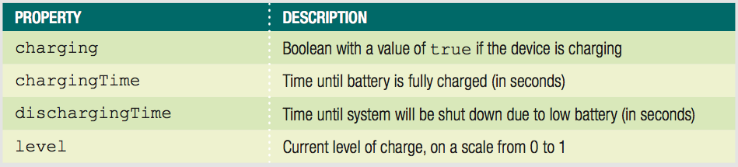
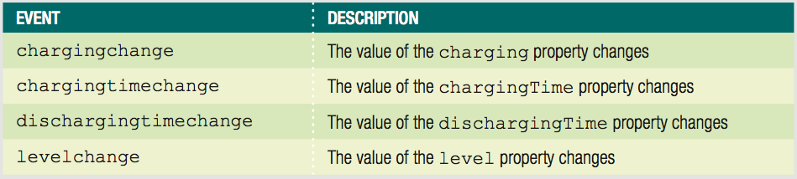
Using the Battery Status API
Adds a battery property to Navigator object
Table 10-10 Properties of the battery object
Table 10-11 Events of the battery object
JavaScript, Sixth Edition

Slide 34
Using the Device Orientation API
Provides access to changes in position and speed
  Gyroscope
    Device hardware that detects orientation in space
    deviceorientation event
      alpha, beta, and gamma coordinate properties
  Accelerometer
    Device hardware that detects changes in speed
    devicemotion event
      reports values for acceleration and rotation
JavaScript, Sixth Edition

Slide 35
Using the WebRTC API
Short for web real-time communication
Enables apps to
  receive data from device camera and microphone
  send and receive audio/video/data in real time
Should eventually allow text/video chat using only HTML and JavaScript
JavaScript, Sixth Edition

Slide 36
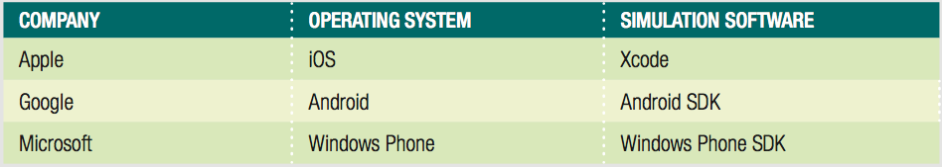
Enhancing Mobile Web Apps
Testing tools
  Often impractical to collect many mobile devices
  Online services available for testing
  Free testing apps from mobile OS makers:
Table 10-12 Software used to simulate mobile devices
JavaScript, Sixth Edition

Slide 37
Enhancing Mobile Web Apps (cont'd.)
Minimizing Download Size
  Mobile speeds usually slower
  Mobile users often have data caps
JavaScript, Sixth Edition

Slide 38
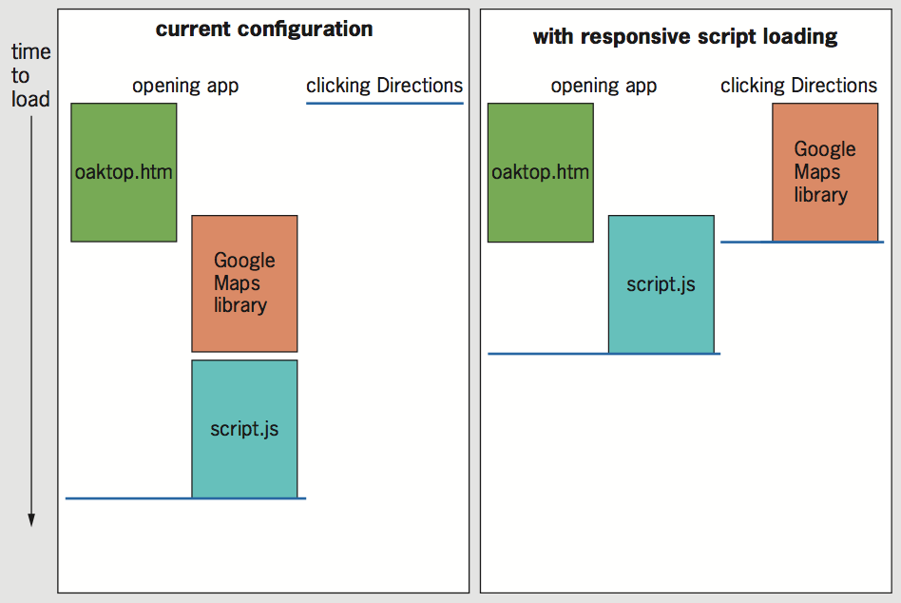
Enhancing Mobile Web Apps (cont'd.)
Minimizing Download Size (cont'd.)
  Loading Scripts Responsively
Figure 10-14 Implementing responsive script loading for oaktop.htm
JavaScript, Sixth Edition

Slide 39
Enhancing Mobile Web Apps (cont'd.)
Minifying Files
  Removes comments, indents, and line breaks
  Tweaks code in other ways to make it smaller
  Online minifying services available
JavaScript, Sixth Edition

Slide 40
Summary
Touch events focus on responding to a user's finger touches on a touchscreen
To ensure OS interface doesn't respond to gestures
  Use the preventDefault() method
Pointer events are different than touch events
  Aim to handle input from mouse, finger, or stylus
Geolocation API provides access to a user's latitude and longitude coordinates
A number of tools exist for testing mobile web apps virtually
JavaScript, Sixth Edition

Slide 41
Summary (cont'd.)
Important to minimize download size of mobile web app
  Load scripts responsively
  Minify files
JavaScript, Sixth Edition

